Slide 1

Chapter 4.3
Means and Variances of Linear Combinations of Random Variables
Means of Linear Combinations of X
If a and b are constant, then
Applying theorem to the discrete random variable g(X) = 2X – 1, rework the carwash example.

Slide 2
Chapter 4.3
Means and Variances of Linear Combinations of Random Variables
Means of Linear Combinations of X
Let X be a random variable with density function
Find the expected value of g(X) = 4X + 3 by using the theorem presented recently.

Slide 3

Chapter 4.3
Means and Variances of Linear Combinations of Random Variables
Means of Linear Combinations of X
The expected value of the sum or difference of two or more functions of a random variable X is the sum or difference of the expected values of the functions. That is
Let X be a random variable with probability distribution as given next. Find the expected value of Y = (X – 1)².

Slide 4
Chapter 4.3
Means and Variances of Linear Combinations of Random Variables
Means of Linear Combinations of X
The weekly demand for a certain drink, in thousands of liters, at a chain of convenience stores is a continuous random variable g(X) = X² + X – 2, where X has the density function
Find the expected value for the weekly demand of the drink.

Slide 5
Chapter 4.3
Means and Variances of Linear Combinations of Random Variables
Means of Linear Combinations of X
The expected value of the sum or difference of two or more functions of a random variables X and Y is the sum or difference of the expected values of the functions. That is
Let X and Y be two independent random variables. Then

Slide 6
Chapter 4.3
Means and Variances of Linear Combinations of Random Variables
Means of Linear Combinations of X
In producing gallium-arsenide microchips, it is known that the ratio between gallium and arsenide is independent of producing a high percentage of workable wafers, which are the main components of microchips.
Let X denote the ratio of gallium to arsenide and Y denote the percentage of workable microwafers retrieved during a 1-hour period. X and Y are independent random variables with the joint density being known as
Illustrate that E(XY) = E(X)E(Y).

Slide 7
Chapter 4.3
Means and Variances of Linear Combinations of Random Variables
Means of Linear Combinations of X
Hence, it is proven that

Slide 8
Chapter 4.3
Means and Variances of Linear Combinations of Random Variables
Means of Linear Combinations of X
If a and b are constant, then
If X and Y are random variables with joint probability distribution f(x, y), then

Slide 9
Chapter 4.3
Means and Variances of Linear Combinations of Random Variables
Means of Linear Combinations of X
If X and Y are random variables with variances , , and covariance σ_{XY} = –2, find the variance of the random variable Z = 3X – 4Y + 8.
Let X and Y denote the amount of two different types of impurities in a batch of a certain chemical product. Suppose that X and Y are independent random variables with variances and . Find the variance of the random variable Z = 3X – 2Y + 5.

Slide 10
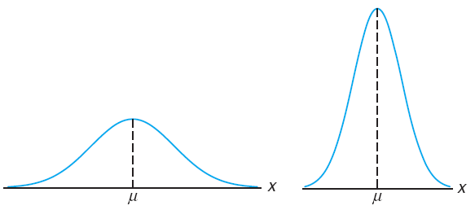
Chapter 4.4
Chebyshev’s Theorem
Chebyshev’s Theorem
As we already discussed, the variance of a random variable tells us something about the variability of the observation about the mean.
If a variable has a small variance or standard deviation, we would expect most of the values to be grouped around the mean.
The probability that a random variable assumes a value within a certain interval about the main is greater in this case.
If we think of probability in terms of area, we would expect a continuous distribution with a small standard deviation to have most of its area close to μ.
Variability of continuous observations about the mean

Slide 11
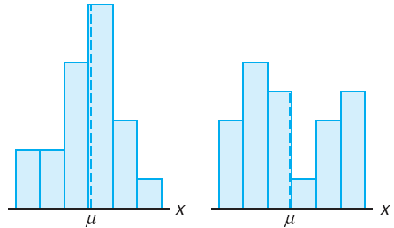
Chapter 4.4
Chebyshev’s Theorem
Chebyshev’s Theorem
We can argue the same way for a discrete distribution. The spread out of an area in the probability histogram indicates a more variable distribution of measurements or outcomes.
Variability of discrete observations about the mean

Slide 12
Chapter 4.4
Chebyshev’s Theorem
Chebyshev’s Theorem
A Russian mathematician P. L. Chebyshev discovered that the fraction of the area between any two values symmetric about the mean is related to the standard deviation.
|Chebyshev’s Theorem| The probability that any random variable X will assume a value within k standard deviations of the mean is at least 1 – 1/k².
That is
Chebyshev’s Theorem holds for any distribution of observations and, for this reason, the results are usually weak.
The value given by the theorem is a lower bound only. Exact probabilities can only be determined when the probability distribution is known.
The use of Chebyshev’s Theorem is relegated to situations where the form of the distribution is unknown.

Slide 13
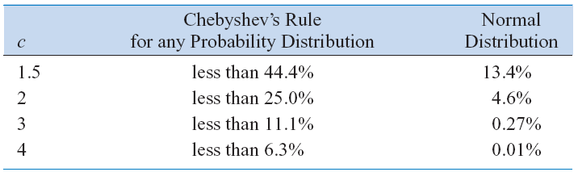
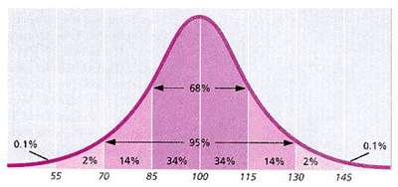
Chapter 4.4
Chebyshev’s Theorem
Chebyshev’s Theorem and Normal Distribution

Slide 14
Chapter 4.4
Chebyshev’s Theorem
Chebyshev’s Theorem
A random variable X has a mean μ = 8, a variance σ² = 9, and an unknown probability distribution. Find
P(–4 < X < 20)
P(|X – 8| ≥ 6)

Slide 15
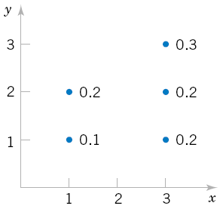
Probability and Statistics
Homework 5A
For the joint probability distribution of the two random variables X and Y as given in the following figure, calculate the covariance of X and Y. (Mo.E5.27 p.0172)
The photoresist thickness in semiconductor manufacturing has a mean of 10 micrometers and a standard deviation of 1 micrometer. Bound the probability that the thickness is less than 6 or greater than 14 micrometers. (Mo.S5.25 p05.15)

